Slide 1
开源平台用户管理设计

Slide 2
主要功能
在线注册，一次注册，全平台通用
单点登录，一次登录，所有平台共享状态
同一账号，平台不同权限不同配置
特殊权限，由管理员配置授予

Slide 3
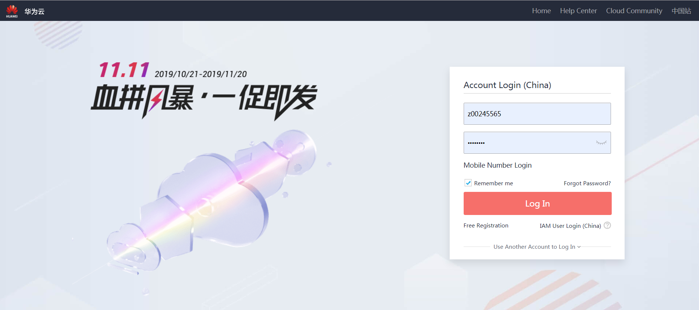
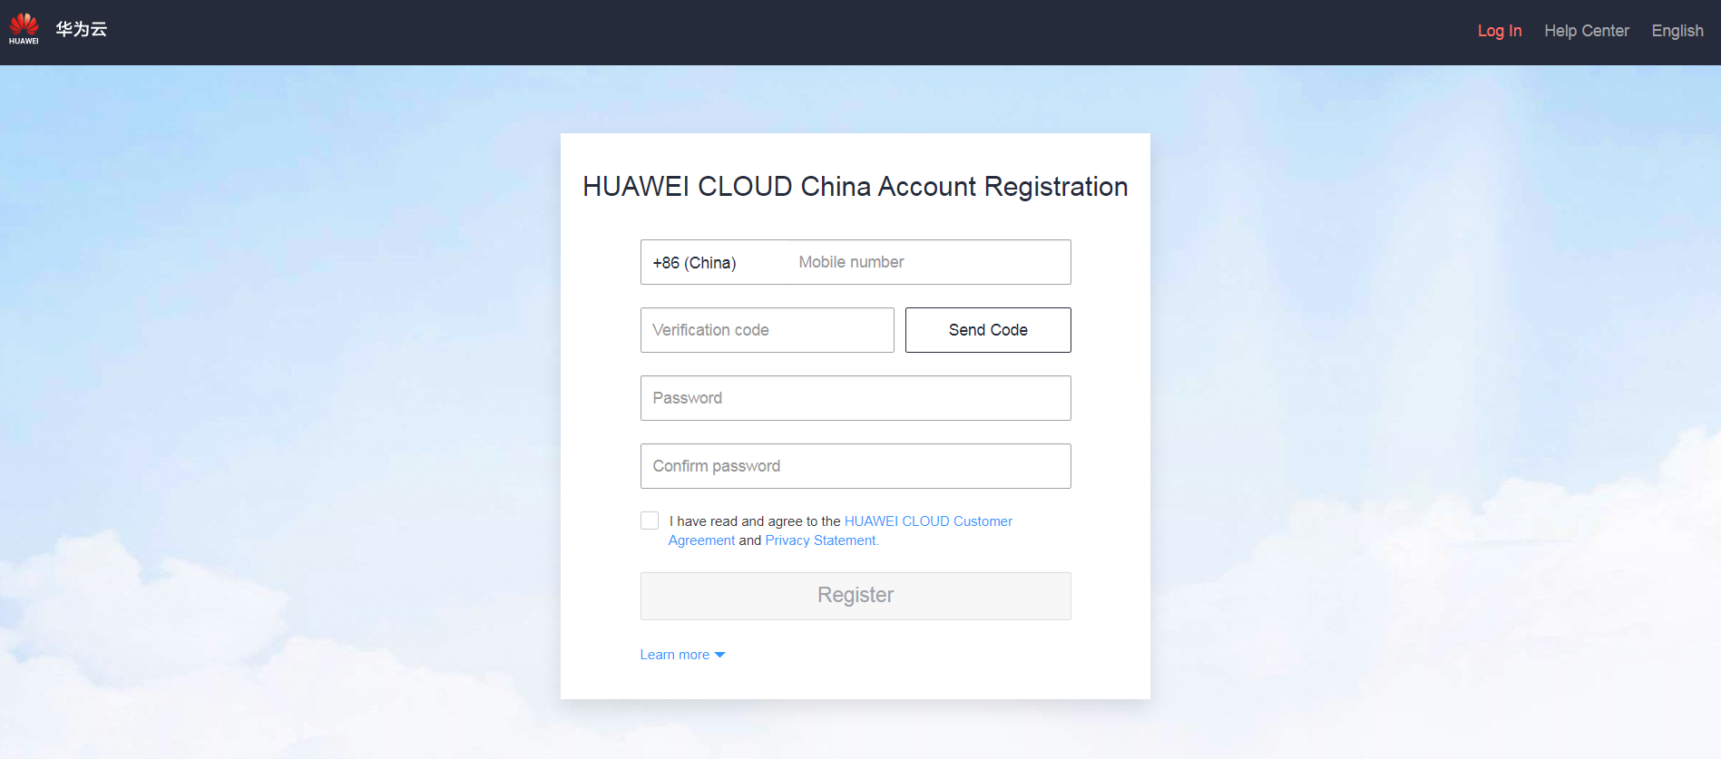
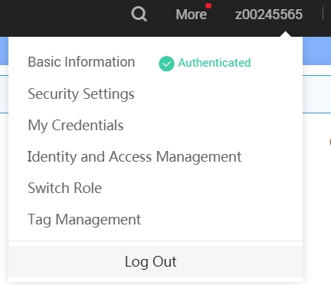
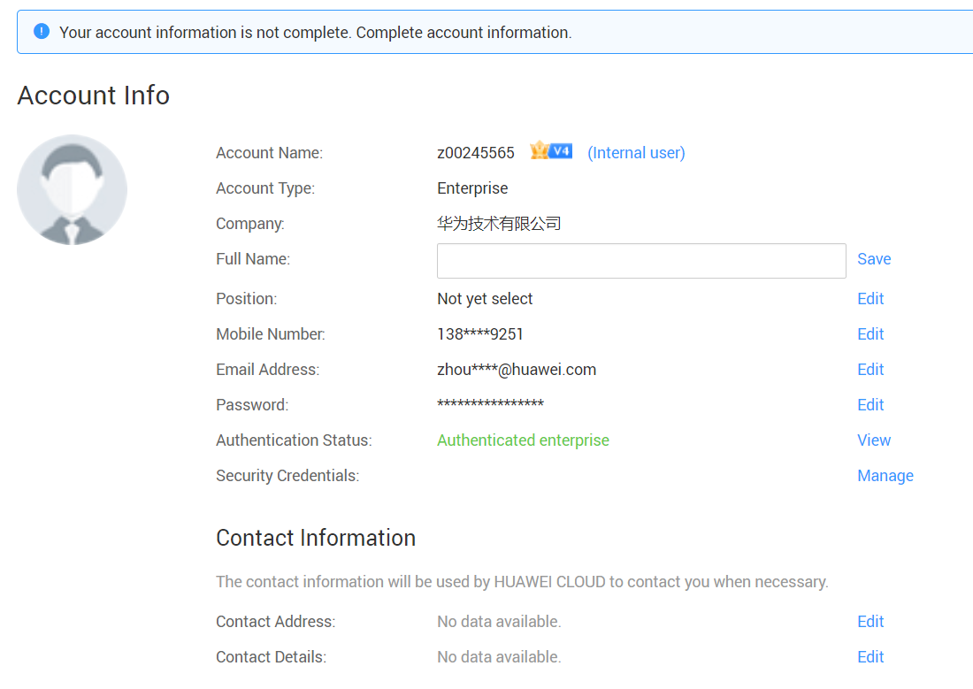
包含的主要界面和API接口
用户管理服务
Tenant-management-service
整体能力基于ONAPaaS平台开发
对外暴露登录url和接口
API
界面
GET：获取用户列表
GET：获取用户详情{tenantId}
POST：新建一个用户
PUT：更新用户基本信息{tenantId}
#包括修改用户基本信息、更新密码、访问权限等
1、在线注册界面
2、登录界面
3、修改密码界面
4、用户基本信息界面
5、用户基本信息小窗口

Slide 4
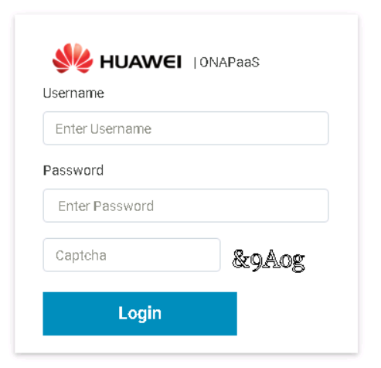
统一登录和注册入口Register Account
Page Address: ONAPaaS -> Login-> Register Account
After online registration, you will get default permission of following Platforms
在线注册后，用户将获得以下平台默认权限
Register
ONAPaaS
手机号:
请填写您的手机号
验证码:
填写验证码
验证码
App Store
昵称:
填写您的昵称
密码:
填写您的密码
MEC Developer
男
女
同意并遵守《服务条款》
MECM
Register
Register
……

Slide 5
User roles on each Platforms
ONAPaaS
MEC Developer
App Store
Guest | Tenant (default) | Admin
Ready only | Ready only | Ready only
 | Operation ONAP | Create new account
 | Upload UseCase | Resource management
 |  | Resource monitoring
 |  | Modify the permission of account
Guest | Developer (default)
Ready | Ready
 | Upload app
 | Test app
Guest | Customer (default) | Developer
Ready | Ready | Ready
 | Download app | Download app
 |  | Upload app
MEO&MEPM
MEO Portal（for customer）
Admin
MEP management
APPLCM
Hosts management
Guest | Customer (default)
Ready | Ready
 | Create order
Notes:
After the user registers online, the default permissions of each platform are obtained;
在线登录后，获得各平台的默认权限
Requires higher privileges to be configured in the admin interface (next page for detail)
如果需要更高权限，需要有管理员进行设置（详见下一页）

Slide 6
架构设计
User-mgmt-service
Restful API
Swagger
Log
Service
DAO
DB
Redis
持久化用户表
Token登录状态

Slide 7
Setting permission
Page Address: ONAPaaS -> User management
Note: login by admin
Account | Telephone | Company | Permission
Zhang san | 138****4589 | Huawei | Modify
Li si | 180****4854 | CMCC | Modify
Set Permission:
User basic:
User name：
Zhang san
Phone No：
180****8888
Sex：
man
Email：
zhangsan@example.com
Company：
Huawei
Address：
Huawei
ID card：
610400********2226
Permission:
ONAPaaS:
Guest
App Store:
Customer
MEO(Portal):
Customer
MEO&MEMP:
None
Guest
Tenant
Admin
None
Guest
Customer
Developer
Admin
None
Guest
Customer
Admin
None
Admin
None

Slide 8
Login flow
登录界面首页
注册新账号
忘记用户名或密码
用户名+密码登录
手机号+验证码登录
输入手机号，获取验证码
输入用户信息
输入手机号，获取验证码
输入用户名+密码
输入验证码
手机获取验证码
手机验证码确认
提交登录
失败，返回错误原因，重新登录
成功
提交登录
失败，返回错误原因，重新登录
提交创建
提交修改
成功
创建成功，跳转到登录
失败，返回错误原因，重新填写信息
修改成功，跳转到登录
失败，返回错误原因，重新填写信息
跳转业务界面

Slide 9
Register a new account (use SMS)
Browser(MEC)
Portal(MEO)
SSO
/ONAPaaS
Redis
DB
Access the login page
Click ”register” to the register interface
Input phone number and other tenant information
Get Verification Code(phone number)
Generate six digit verification code by phone number
Send verification code to user by SMS
Input verification code
submit
Failed
If timeout or code error, return failed
Return code: 401
Pass
If the token passes verification, set the status to active
Store this account to active
Return code: 200

Slide 10
Login flow (SSO)---first login
Browser(MEC)
Portal(MEO)
SSO
Redis
Access the Home Page
Don’t find token from Cookie
Redirect to the login page
Input Username and Password
Post username & password
Verify user
Verify pass, generate token
Return token and User Informations
Save token
Return Code:302, and the target link(MEOP Home Page)
Save token to the Cookie
Save token to the Cookie
Redirect to the Home Page of MEOP

Slide 11
Login flow (SSO)---has logged and get token
Browser
MEO
SSO
Redis
Access the Home Page of MEOP
Find token from Cookie
Get user by token
Query login status by token
Login verification succeeded
Return: success
Return user informations
Return request page
Login verification failed
Return: not logged in
Return not logged in
Redirect to login page

Slide 12
APIs of Login
API name | Type | Input/type | Output/type
v1/tenant/auth | POST | Username/String Password/String | Token/String
v1/tenant/getTenantInfos | GET | Token/String | TenantInfo/json
TenantInfo detail：
Attribute | Type | Required | Sample
Username | String | Y | Demo
Password | String | Y | demo123456!
tenantId | String | Primary key | UUID
auth | Map | Y | {“MEO_Portal”:[“admin”,”customer”],”AppStore”:[“admin”]}
Email | String | Y
Company | String | Y | Huawei or CMCC
Telephone | String | N
… | …

